Slide 1

National Institute of Technology Andhra Pradesh
Introduction to Machine Learning Project ( EE363 )
Topic : Language Translation using Recurrent Neural Network
Team Members :
Y Rakesh ( 521260 ) Siraj ( 521240 )
Project Guidance :
Dr. Sri Phani Krishna Karri Assistant Professor

Slide 2
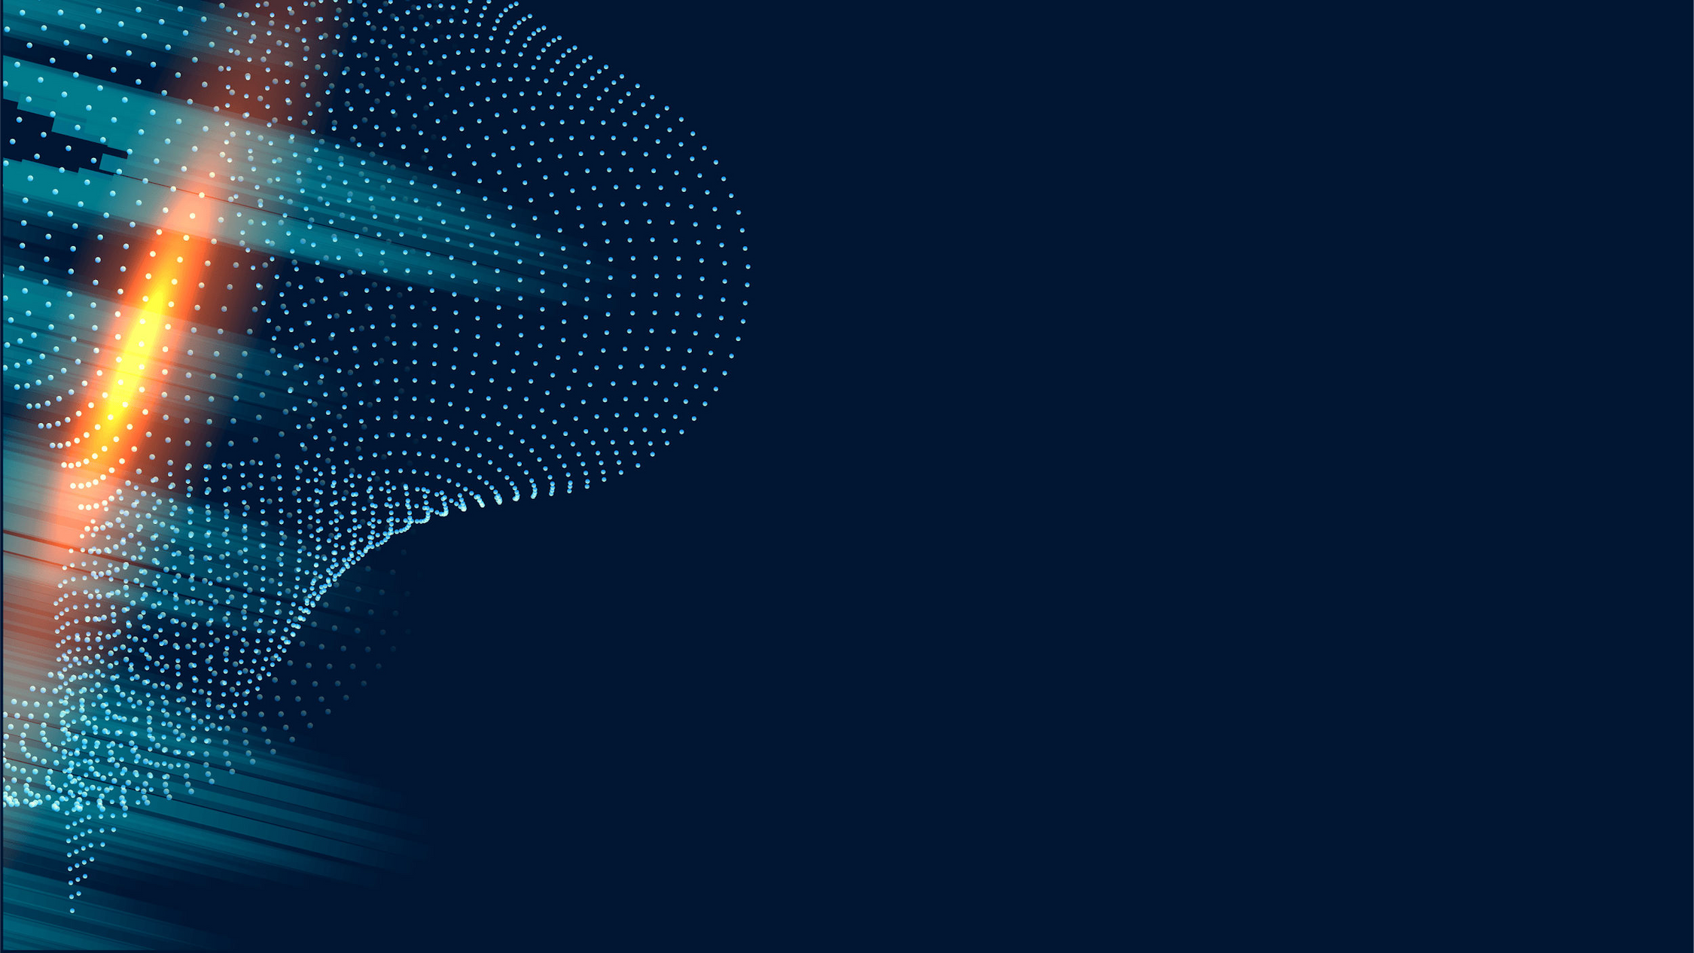
Introduction
Language translation is crucial for communication across different linguistic communities, fostering collaboration and understanding.
This project aims to develop a machine translation system capable of translating English sentences to French using state-of-the-art deep learning techniques, specifically Recurrent Neural Networks (RNNs).
Recurrent Neural Networks (RNNs) as a powerful tool for sequence-to-sequence tasks like language translation.

Slide 3

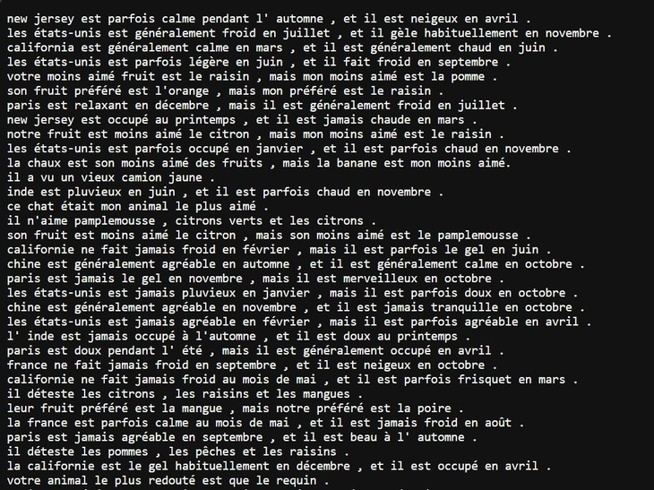
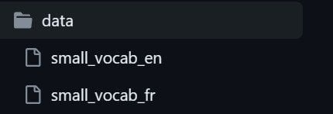
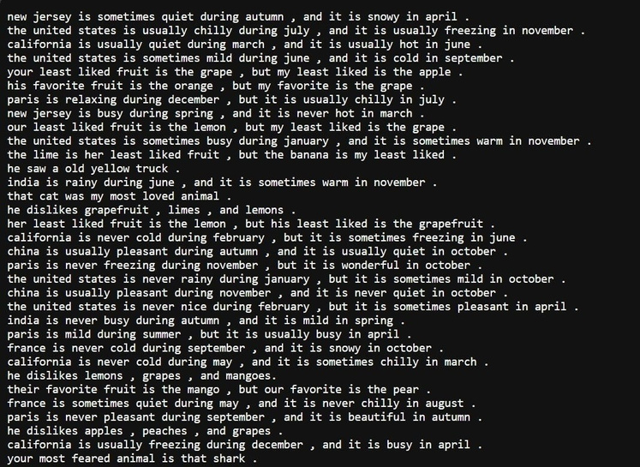
French text file
Dataset
The dataset contains 2 text ﬁles - English text ﬁle and French text ﬁle. Each ﬁle contains 137860 lines of sentences.
English ﬁle summarized as 1823250 english words.
French ﬁle summarized as 1961295 french words.
English text file

Slide 4

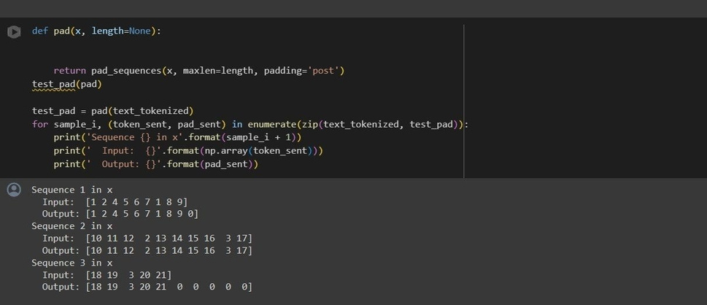
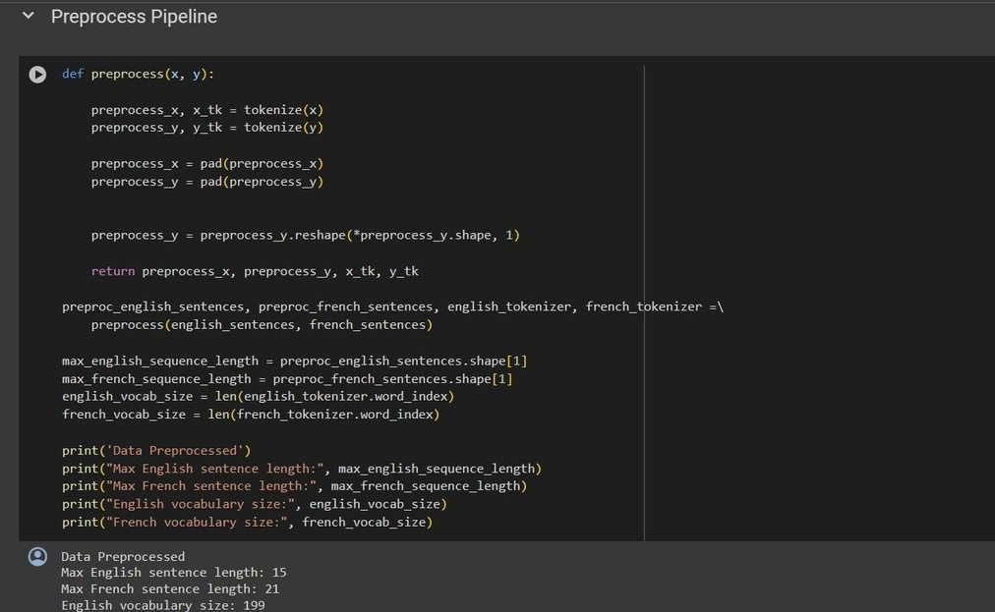
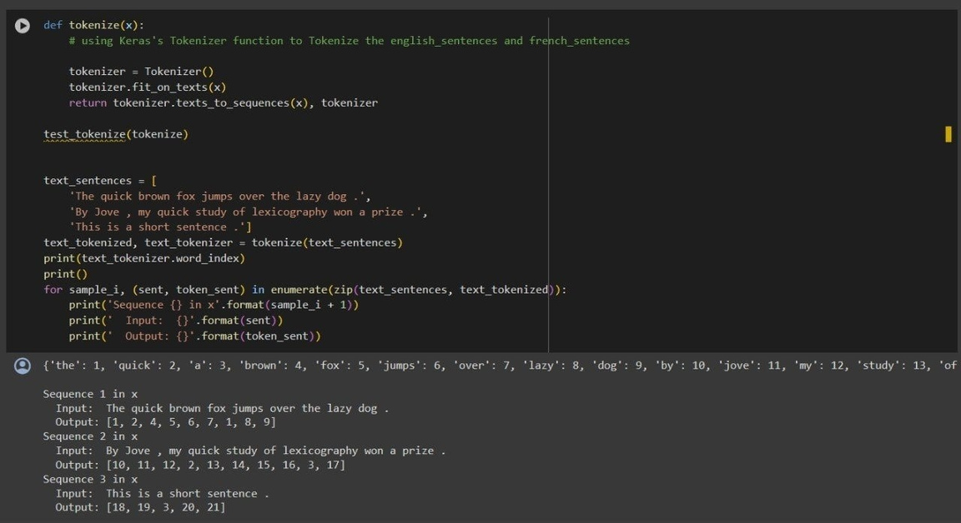
Data Preprocessing
Preprocessing
Tokenization
Padding

Slide 5
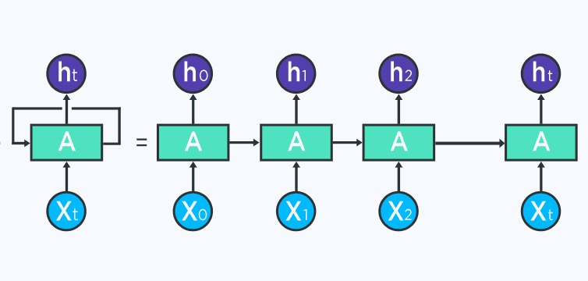
Recurrent Neural Network ( RNN )
RNNs are well-suited for language translation tasks due to their ability to capture sequential dependencies in input and output sequences.
The recurrent nature of RNNs enables them to process variable-length input sequences, making them adaptable to different languages and sentence structures.
By training on large bilingual corpora, RNNs can learn complex language patterns and nuances, resulting in high-quality translation outputs. Attention mechanisms in RNN-based translation models allow the model to focus on relevant parts of the input sequence during translation, improving translation accuracy and ﬂuency.

Slide 6
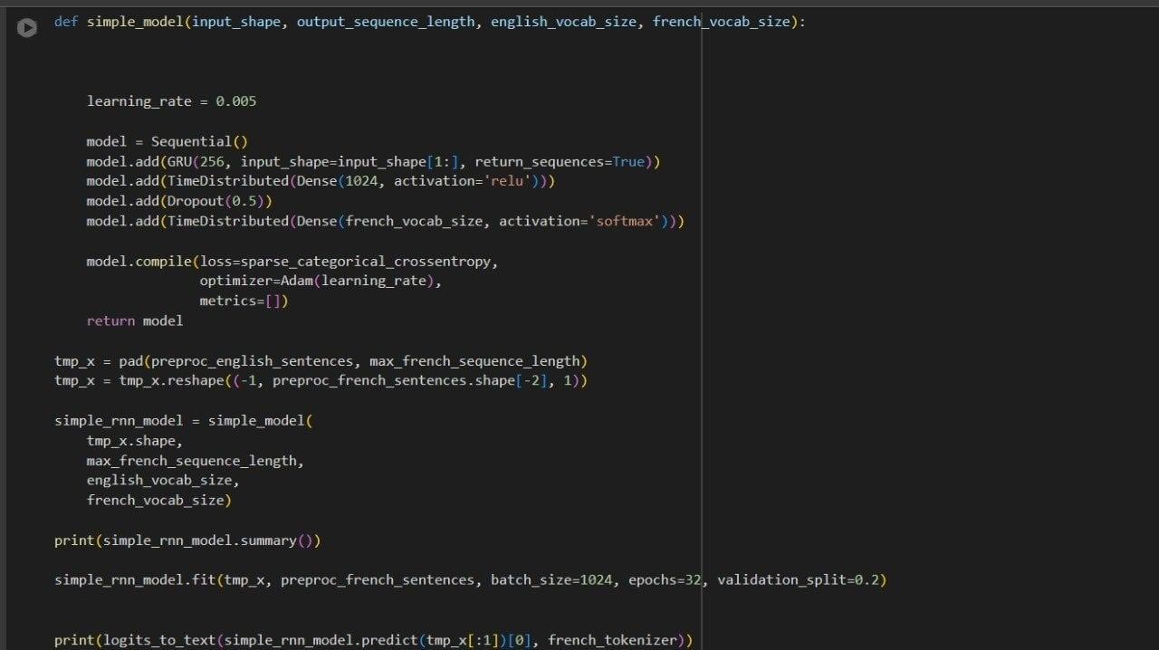
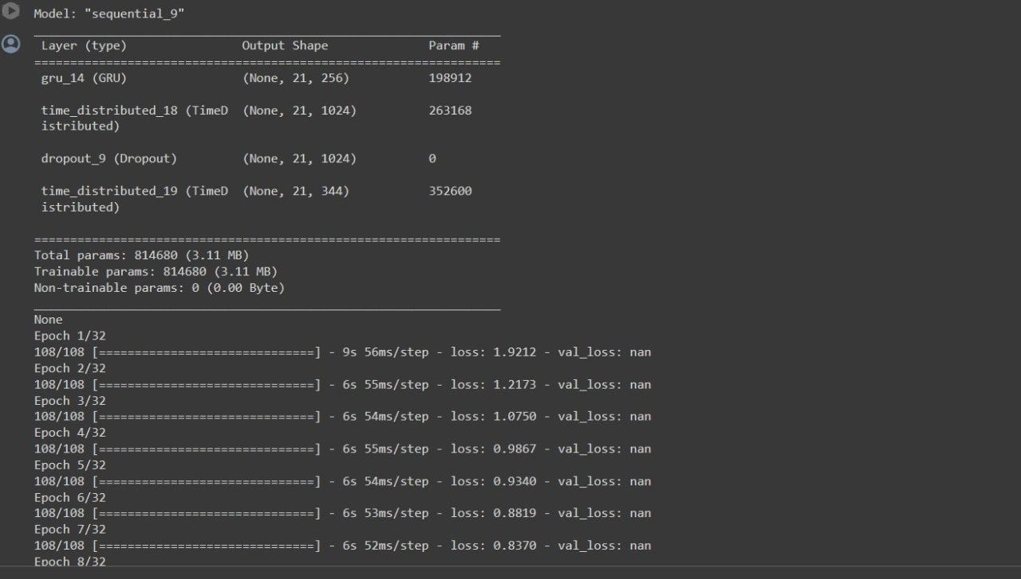
RNN Trained Model

Slide 7

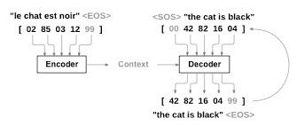
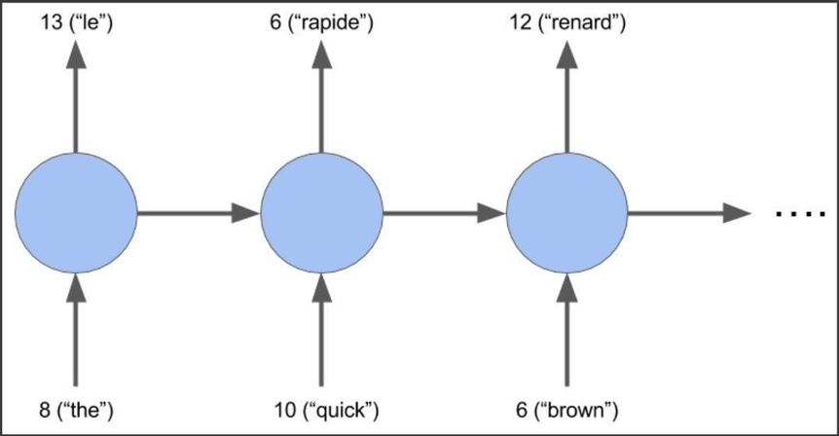
Language Translation
Language translation in machine learning involves the development of systems capable of automatically translating text or speech from one language to another.
Machine translation systems leverage various techniques from natural language processing (NLP) and machine learning to translate text
or speech between languages.
Traditional approaches to machine translation
include rule-based methods, statistical
machine translation (SMT), and neural
machine translation (NMT).
Evaluation of machine translation systems
often relies on metrics such as BLEU (Bilingual
Evaluation Understudy) score, METEOR, and
human judgment to assess translation quality
and ﬂuency.

Slide 8
Overview of Project
Methodology: Recurrent Neural Networks (RNNs) are employed for language translation, utilizing an encoder-decoder architecture.
Optimization: Training utilizes optimization techniques such as stochastic gradient descent (SGD) or its variants like Adam optimizer, with adaptive learning rates and gradient clipping.
Metrics: Translation quality is assessed using metrics like BLEU (Bilingual Evaluation Understudy) score, which measures the overlap between machine- generated translations and human reference translations
Training Process: The model is trained to minimizing a loss function (e.g., cross- entropy loss) to maximize the likelihood of producing correct translations. Evaluation: The trained model is evaluated on a separate validation or test set using established metrics, ensuring translation accuracy, ﬂuency, and preservation of meaning across languages.

Slide 9
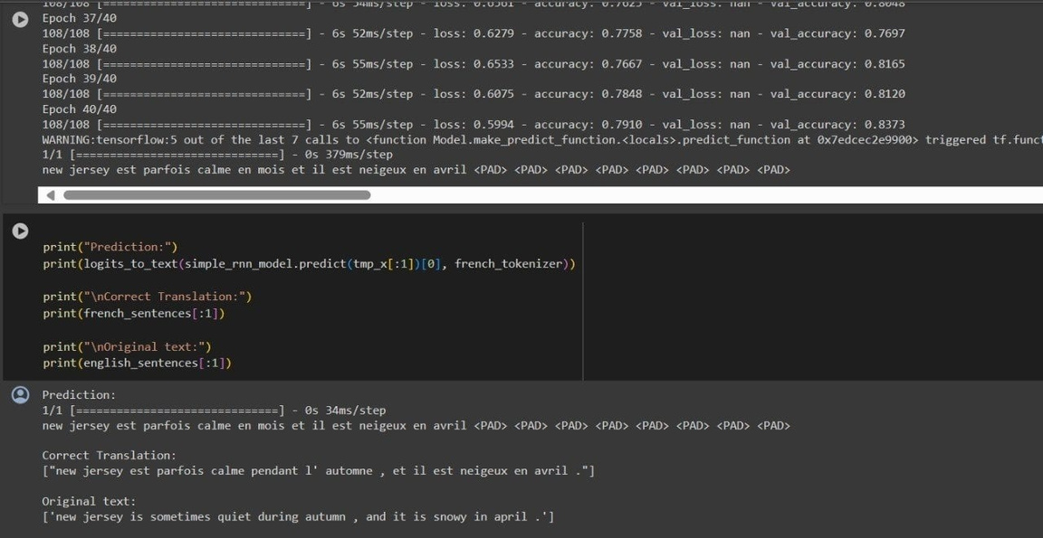
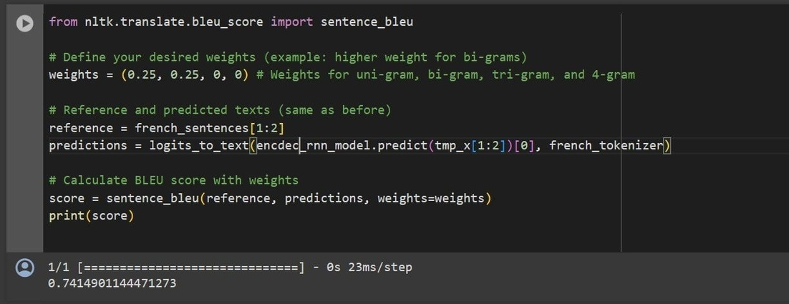
Trained model Output
Metric :
BLEU Score

Slide 10

Conclusion
Language translation using Recurrent Neural Networks (RNNs) is a powerful and effective approach to automatic translation between languages.
RNN-based translation models excel at capturing sequential dependencies and nuances in language, enabling accurate and fluent translations.
The encoder-decoder architecture, combined with attention mechanisms, allows RNNs to handle variable-length input and output sequences, facilitating translation of texts of varying complexities.
RNN-based language translation systems play a crucial role in bridging language barriers and fostering global communication and understanding.

Slide 11
Thank You for your kind attention.

